Slide 1
Teach a child to read
and keep that child reading [and talking]
and we will change everything.
And I mean everything.
Jeanette Winterson
Notes:
This is what we do in our Nursery.
Read quote.
We have added ‘and talking’ because it is central to everything we do in our Nursery.
Research shows that children who learn to read quickly go on to succeed in school and in life.
Being able to read and use a wide range of vocabulary changes everything.

Slide 2
What is Read Write Inc. Phonics?
Notes:
Read question.

Slide 3
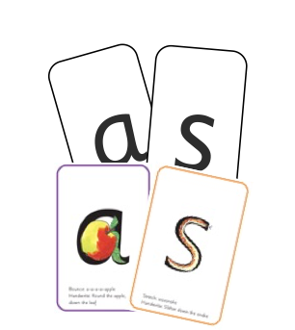
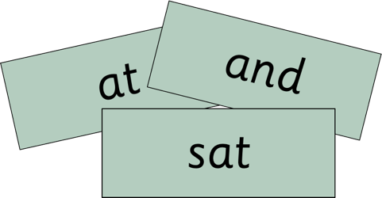
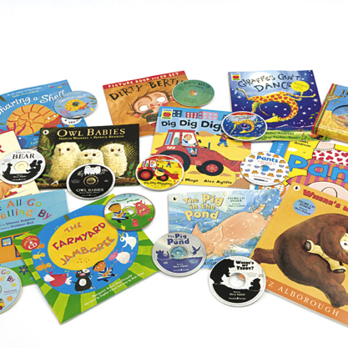
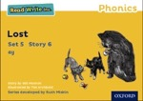
Systematic approach
Notes:
Read Write Inc. Phonics is a programme that uses systematic phonics to teach all children to read.
Click – We teach the sounds first – in a specific order.
Click – We then teach your children to blend those sounds together in order to read words using something called Fred Talk.
Click – When the children reach Reception, they will read words in the matched Storybooks. Each Storybook is carefully matched to the sounds they can already read - setting them up for success.
Click – We read to children ‘real’ books’ during storytime. Once they have learnt to read, they will be able to independently read these books for themselves.

Slide 4
How do we prepare children to learn the sounds?
Notes:
Before we begin teaching the sounds, we must teach children to…. (click to next slide)

Slide 5
Storytime
Love stories
Love words
Love reading
Notes:
Click and read each point.
We want all our children to be lifelong readers, we want children who want to read. The most important thing we can do in Nursery and at home, before we begin to teach the sounds, is to read stories to children.

Slide 6
How do we encourage children to love stories?
Notes:
Children who are read to a lot, love stories and eventually want to be readers who can read stories for themselves. In our Nursery we take pride in helping children to grow to love stories.

Slide 7
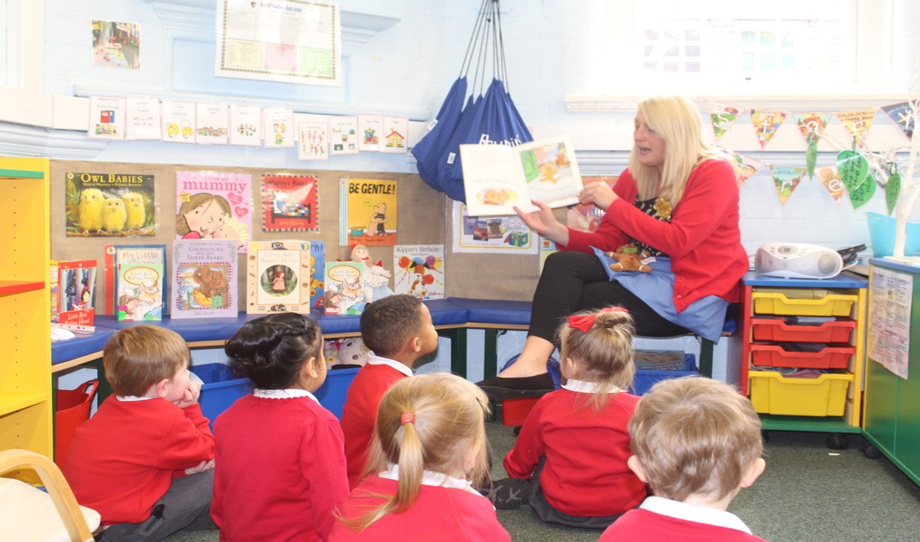
Daily Storytime
Notes:
We make time to read stories every day.
We have key stories that the children hear over again (mention some favourites from your Nursery)
We help children to learn words and phrases from the story (Demonstrate some key phrases your children know or will know off by heart)
We give lots of opportunities for children to act out the story using the words and phrases that they know (You could insert photographs on a separate slide of story based role play indoor or outdoor)

Slide 8
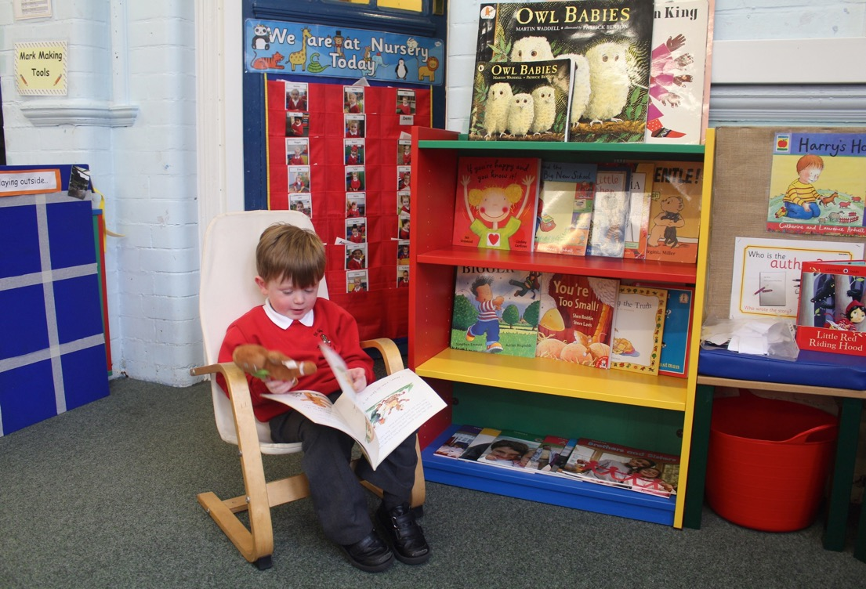
Loving stories is important because….
Notes:
Loving stories is important because children who love stories want to read stories for themselves. Children who read a lot become better readers.

Slide 9
How do we help children to love words?
Notes:
Read question.
Storybooks contain lots of words that are new to children. Demonstrate a few e.g. the front cover of Commotion in the Ocean, what is a commotion/ocean? In Aliens love Underpants what are bloomers and long johns? What does lurk unseen mean?
Children who know lots of words, understand stories much better. By teaching new words we are teaching language comprehension and this is really important for reading.

Slide 10
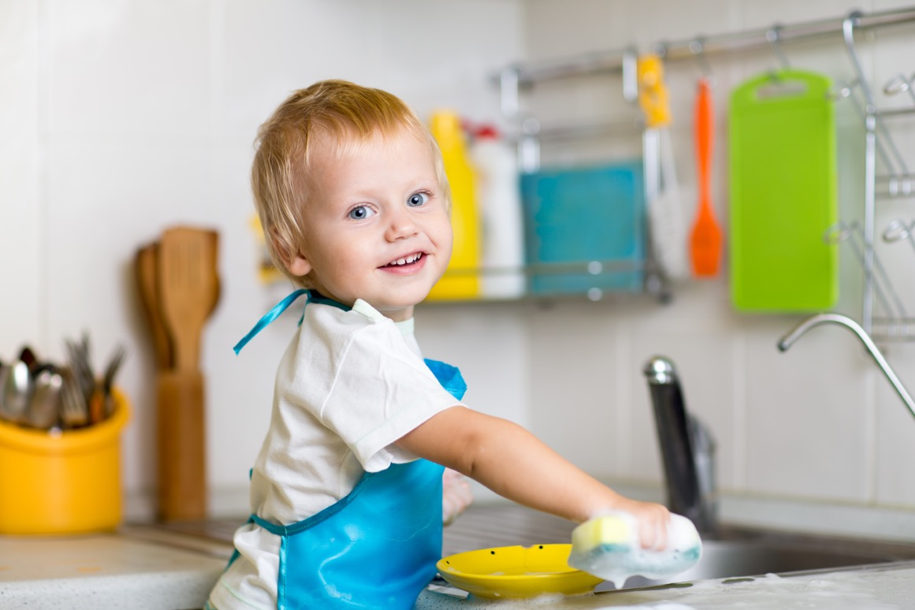
Talk to your child
Notes:
Talk to your child about what you are doing at home. Even if it is an every day task like washing up. Try out new words with your child.
“These plates are not just clean, they are sparkling.” “The washing up bowl is so full that it is almost overflowing”.
Praise your child for trying out any new words they have learned.
Authors use lots of different and interesting vocabulary, the more words your child knows and understands, the more they will be able to understand the stories you read and those they eventually read for themselves.

Slide 11
What is systematic phonics?
Notes:
Read question.

Slide 12
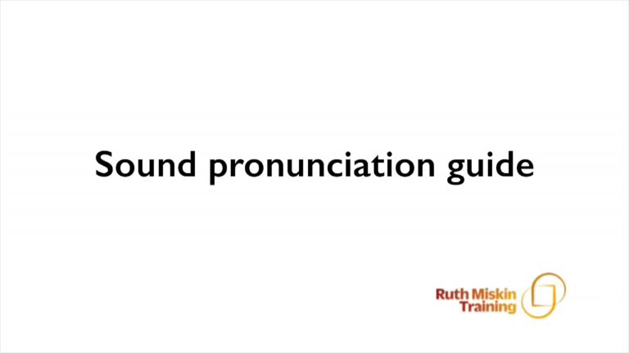
Pure Sounds
Notes:
We teach using pure sounds.
We use pure sounds (‘m’ not’ muh’, ’s’ not ‘suh’, etc.) so that your child will be able to blend the sounds into words more easily.
Children need to know sounds – not letter names – to read words.
This video of Sylvie – available on the website – demonstrates how to talk in pure sounds. Play video.

Slide 13
Systematic Phonics
Sounds
Graphemes
Notes:
The English language is very complex.
Phonics is the method of teaching reading through the identification of sounds and graphemes.
Click. All words are made up of sounds e.g. in ‘mat’ we have the sounds ‘m’, ‘a’, ‘t’.
Click A grapheme is another name for the letters we use to write the sound. Write the letters ‘m’ ‘a’ ‘t’ in the air as you say the sounds.
We teach phonics so that your children will have the tools to read any word.

Slide 14
English alphabetic code
44 sounds
Over 150+ graphemes
One of the most complex alphabetic codes in the world.
Notes:
In English we have more than 150 ways to represent 44 sounds, using the 26 letters in the alphabet.
This means we have to group letters together to write some sounds. Show with a grapheme such as ‘igh’.
This makes our language one of the most complex in the world!

Slide 15
The first sounds that we teach
Notes:
In Nursery we start with the sounds in the grey boxes first as these are the most common sounds children need to read and spell simple words. In Read Write Inc. these are called Set 1 Speed Sounds.

Slide 16
Blending sounds to make words
Green and red words

Slide 17
How can you help at home?
Notes:
Read question.

Slide 18
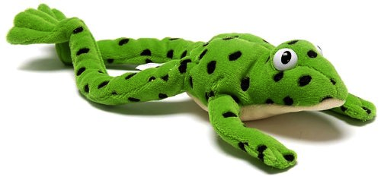
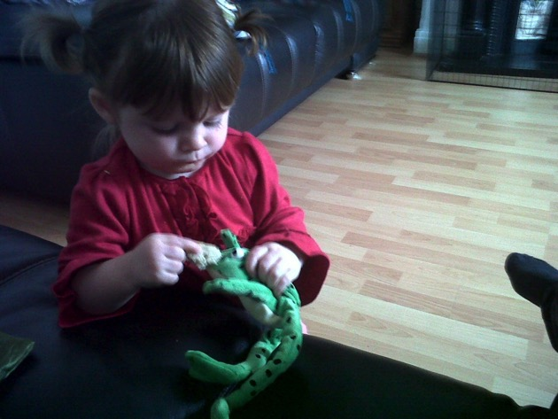
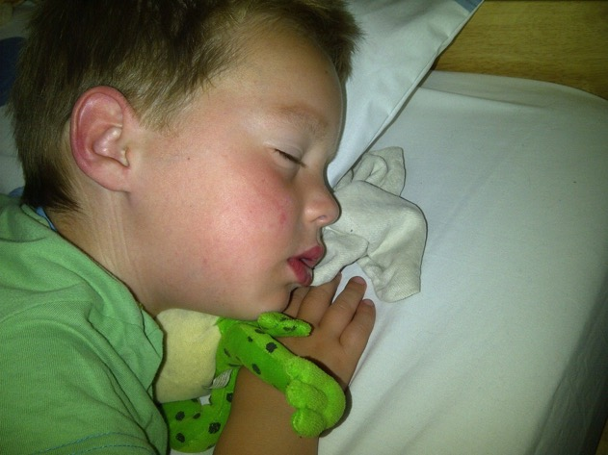
Fred Talk
Notes:
This is Fred.
He is a frog who can only speak in sounds, and we call this Fred Talk. For example ‘m’ ‘a’ ‘t’, ‘l’ ‘u’ ‘n’ ‘c’ ‘h’.
He helps children sound out words so they can read and spell.
MTYT some examples with the parents. For example ‘m’ ‘a’ ‘t’ mat, ‘s’ ‘a’ ‘t’ sat.
Click. Fred is our friend!
Alongside our Speed Sounds lessons, we use Fred talk so that children become more and more confident with putting sounds together ready to read words.

Slide 19
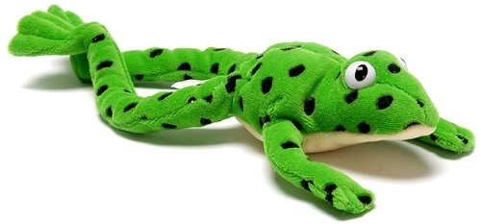
Fred Talk
“Time for b e d.”
“Get your c oa t.”
“Eat your l u n ch.”
Notes:
Practise talking like Fred with your child. Remember to tell them the word until they can work it out by themselves and make sure you use pure sounds otherwise your child will not be able to work out the word.
Demonstrate the sentences on the slide.

Slide 20

Fred Fingers
Notes:
We use Fred Fingers to help children sound out words to spell easily. This is a tool that helps them spell any word. It means children do not have to memorise lots of words before they can try writing.
Demonstrate how to use Fred Fingers with a simple word like cat. Ask parents to hold up three fingers and show how the children say cat and pinch the sounds and write them down.

Slide 21
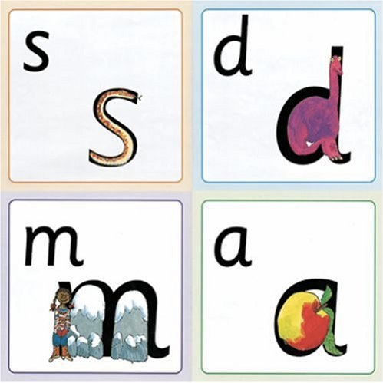
My Reading and Writing Kit
Notes:
A Parent resource pack is available (My Reading and Writing Kit) – it contains a frieze, speed sounds cards to use with your child, handwriting practice and a parent handbook.

Slide 22
Further online resources
Ruth Miskin Facebook:
https://www.facebook.com/miskin.education
Free e-books for home reading:
http://www.oxfordowl.co.uk/Reading/
Notes:
Clips to help parents are also put on the Ruth Miskin Facebook page, and there is an opportunity to leave questions that will be answered by a member of the Ruth Miskin team.
The Oxford Owl website address gives you access to free e books to share with your child at home.

Slide 23

Any other questions?
Notes:
Are there any questions?
Myself and the team are available to talk with you after the meeting if you would rather wait for a more private discussion.

Slide 24
Teach a child to read
and keep that child reading [and talking]
and we will change everything.
And I mean everything.
Jeanette Winterson
Notes:
In our Nursery we want to help every child to love words, love stories and love reading, because reading changes everything.

